Slide 1

CS 7081 Advanced Algorithms
Final Project
Team 01
Christopher Broderick,
Rohit Dureja,
Akash Mohapatra,
Bill Nicholson,
Asrith Singa Reddy.
[1]

Slide 2
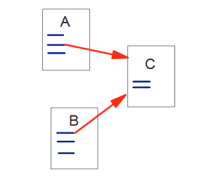
Page Rank
[2]

Slide 3
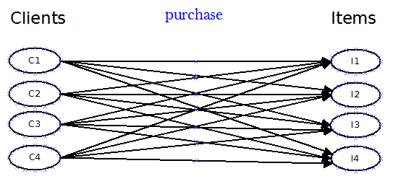
Apply Page Rank to
Every Client has purchased every Item
Bipartite Unweighted Directed Graph
These ‘links’ are organic: clients link to items by purchasing them.
There are no links from Items to Clients!

Slide 4
Transition Matrix from Previous Slide
 | I1 | I2 | I3 | I4 | C1 | C2 | C3 | C4
I1 | 0 | 0 | 0 | 0 | 0.25 | 0.25 | 0.25 | 0.25
I2 | 0 | 0 | 0 | 0 | 0.25 | 0.25 | 0.25 | 0.25
I3 | 0 | 0 | 0 | 0 | 0.25 | 0.25 | 0.25 | 0.25
I4 | 0 | 0 | 0 | 0 | 0.25 | 0.25 | 0.25 | 0.25
C1 | 0 | 0 | 0 | 0 | 0 | 0 | 0 | 0
C2 | 0 | 0 | 0 | 0 | 0 | 0 | 0 | 0
C3 | 0 | 0 | 0 | 0 | 0 | 0 | 0 | 0
C4 | 0 | 0 | 0 | 0 | 0 | 0 | 0 | 0

Slide 5

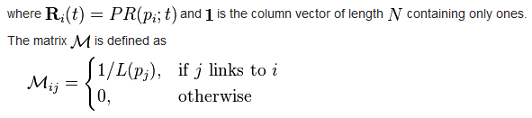
Page Rank: compute the ranking vector

Slide 6
Compute the ranking vector
After 20 iterations: final state of the Ranking Vector:
I1 0.12219
I2 0.12219
I3 0.12219
I4 0.12219
C1 0.10625
C2 0.10625
C3 0.10625
C4 0.10625
(Damping Factor of .85 allows the unlinked nodes to earn a non-zero ranking)

Slide 7
We need weights
Google’s Page Rank (probably) doesn’t use weights.
We can add weights to our domain
What if Client C1 buys 10 of Item I1?

Slide 8
Client C1 Buys 10 of Item I1
 | I1 | I2 | I3 | I4 | C1 | C2 | C3 | C4
I1 | 0 | 0 | 0 | 0 | 10./13 | 0.25 | 0.25 | 0.25
I2 | 0 | 0 | 0 | 0 | 1./13 | 0.25 | 0.25 | 0.25
I3 | 0 | 0 | 0 | 0 | 1./13 | 0.25 | 0.25 | 0.25
I4 | 0 | 0 | 0 | 0 | 1./13 | 0.25 | 0.25 | 0.25
C1 | 0 | 0 | 0 | 0 | 0 | 0 | 0 | 0
C2 | 0 | 0 | 0 | 0 | 0 | 0 | 0 | 0
C3 | 0 | 0 | 0 | 0 | 0 | 0 | 0 | 0
C4 | 0 | 0 | 0 | 0 | 0 | 0 | 0 | 0
Computed Ranking vector:
I1 0.13046
I2 0.11943
I3 0.11943
I4 0.11943
C1 0.10625
C2 0.10625
C3 0.10625
C4 0.10625
This still generates uniform ranks
for all Clients because the damping factor is the only way we traverse client nodes.

Slide 9

We need directed edges from Items to Clients
There is no organic link from Item to Client
Items do not ‘vote for’ Clients
[5]

Slide 10

There are ways…
Link Item to Client that purchased the item
Weighted by the cost of the item X qty
[4]

Slide 11
Results
4 items to be processed.
4 clients to be processed.
0.000 0.000 0.000 0.000 0.533 0.067 0.476 0.095
0.000 0.000 0.000 0.000 0.267 0.133 0.238 0.190
0.000 0.000 0.000 0.000 0.133 0.267 0.190 0.238
0.000 0.000 0.000 0.000 0.067 0.533 0.095 0.476
0.381 0.267 0.133 0.048 0.000 0.000 0.000 0.000
0.048 0.133 0.267 0.381 0.000 0.000 0.000 0.000
0.476 0.333 0.267 0.095 0.000 0.000 0.000 0.000
0.095 0.267 0.333 0.476 0.000 0.000 0.000 0.000
Initial state of Ranking vector:
0.12500
0.12500
0.12500
0.12500
0.12500
0.12500
0.12500
0.12500
Final state of Ranking vector:
0.14278
0.10722
0.10722
0.14278
0.10722
0.10722
0.14278
0.14278

Slide 12
The Computed Transition Matrix
 | I1 | I2 | I3 | I4 | C1 | C2 | C3 | C4
I1 | 0 | 0 | 0 | 0 | 0.533 | 0.067 | 0.476 | 0.095
I2 | 0 | 0 | 0 | 0 | 0.267 | 0.133 | 0.238 | 0.19
I3 | 0 | 0 | 0 | 0 | 0.133 | 0.267 | 0.19 | 0.238
I4 | 0 | 0 | 0 | 0 | 0.067 | 0.533 | 0.095 | 0.476
C1 | 0.381 | 0.267 | 0.133 | 0.048 | 0 | 0 | 0 | 0
C2 | 0.048 | 0.133 | 0.267 | 0.381 | 0 | 0 | 0 | 0
C3 | 0.476 | 0.333 | 0.267 | 0.095 | 0 | 0 | 0 | 0
C4 | 0.095 | 0.267 | 0.333 | 0.476 | 0 | 0 | 0 | 0

Slide 13
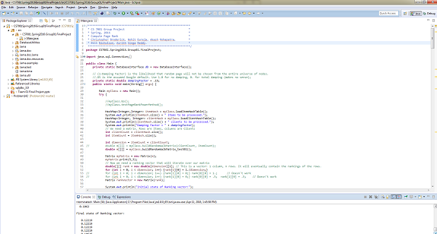
References
[1] Search.Dilbert.com
[2] Page, Lawrence, et al. "The PageRank citation ranking: bringing order to the web." (1999).
[3] http://www.ams.org/samplings/feature-column/fcarc-pagerank
[4] https://en.wikipedia.org/wiki/PageRank
[4] YouTube.com
[5] www.beanstalkim.com
Code and presentation available at https://github.com/nicomp42/CS7081Spring2016Group01FinalProject

